Slide 1

v.0.0.1

Slide 2
What will you learn today?
1
The basics of Git and GitHub
2
The GitHub Workflow
3
Command-line Git usage
Notes:
What to Say:
Explain to participants what they will learn today
Learning is a core part of being a hacker and today they are going to learn something new
What to Do:
Get participants excited about the experience.

Slide 3
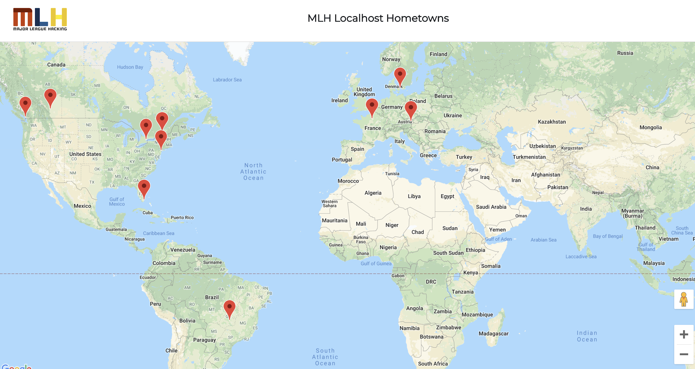
What You'll Be Building
http://mlhlocal.host/github-demo
Notes:
We will be using githubs workflow sharing abilities to add your hometown to the markdown file that is used to generate this data on the map.
We are going to have to use a bit of imagination here due to some technical issues and not having a google maps API key!

Slide 4


How Will You Build It?
Make an account on GitHub.
Fork the repo that contains the source code for the website you just looked at.
Add your hometown and make a pull request.
Comment on someone else's pull request.
The workshop organizer will approve and merge pull requests.
Refresh the main website to see people being added!
Notes:
Just a roadmap of what we will be doing!

Slide 5
Now that you understand how it works, let's get started!

Slide 6
4.

Slide 7
We're all going to collaborate on a project together. How? Version control!

Slide 8


Git vs. GitHub
What's the difference?
Git
GitHub
Git is a version control system.
It can be used with various tools or locally on your computer to help you keep track of changes in your code projects.
Think of it like Google Docs for code, but better.
GitHub is a platform for code collaboration!
GitHub uses Git for version control and provides you all sorts of awesome collaboration tools.

Slide 9
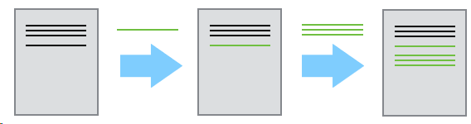
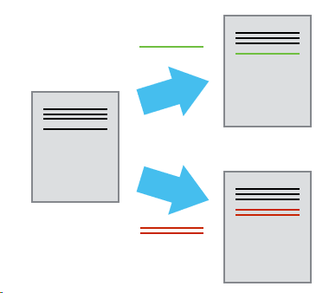
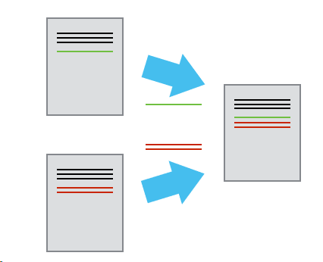
Why version control?
Because emailing a file around is painful
Version control features:
Log changes in a searchable way, instead of renaming a file for each version.
Collaborators can work in parallel and merge their changes automatically, instead of manually comparing the differences between a file
Graphics taken from the Software Carpentry Git Lesson*
Notes:
Git is a Version Control System. It’s a tool to solve the problem of collaborating with multiple people. It works well if you’re collaborating on one file or a million files. Scalability!

Slide 10
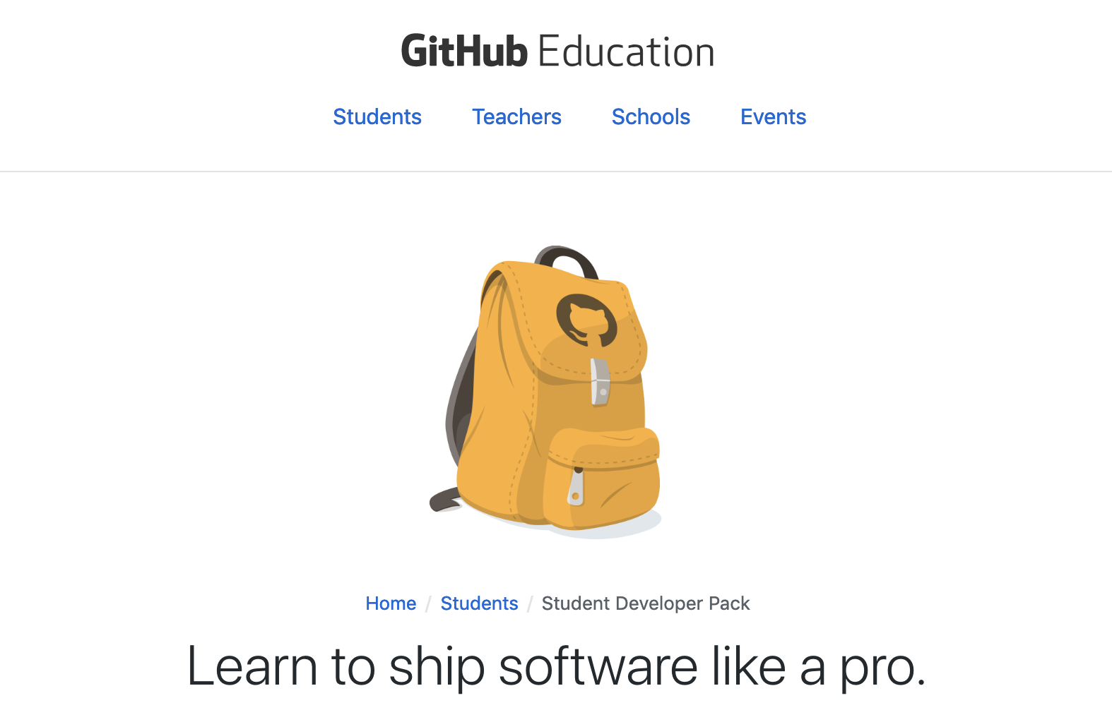
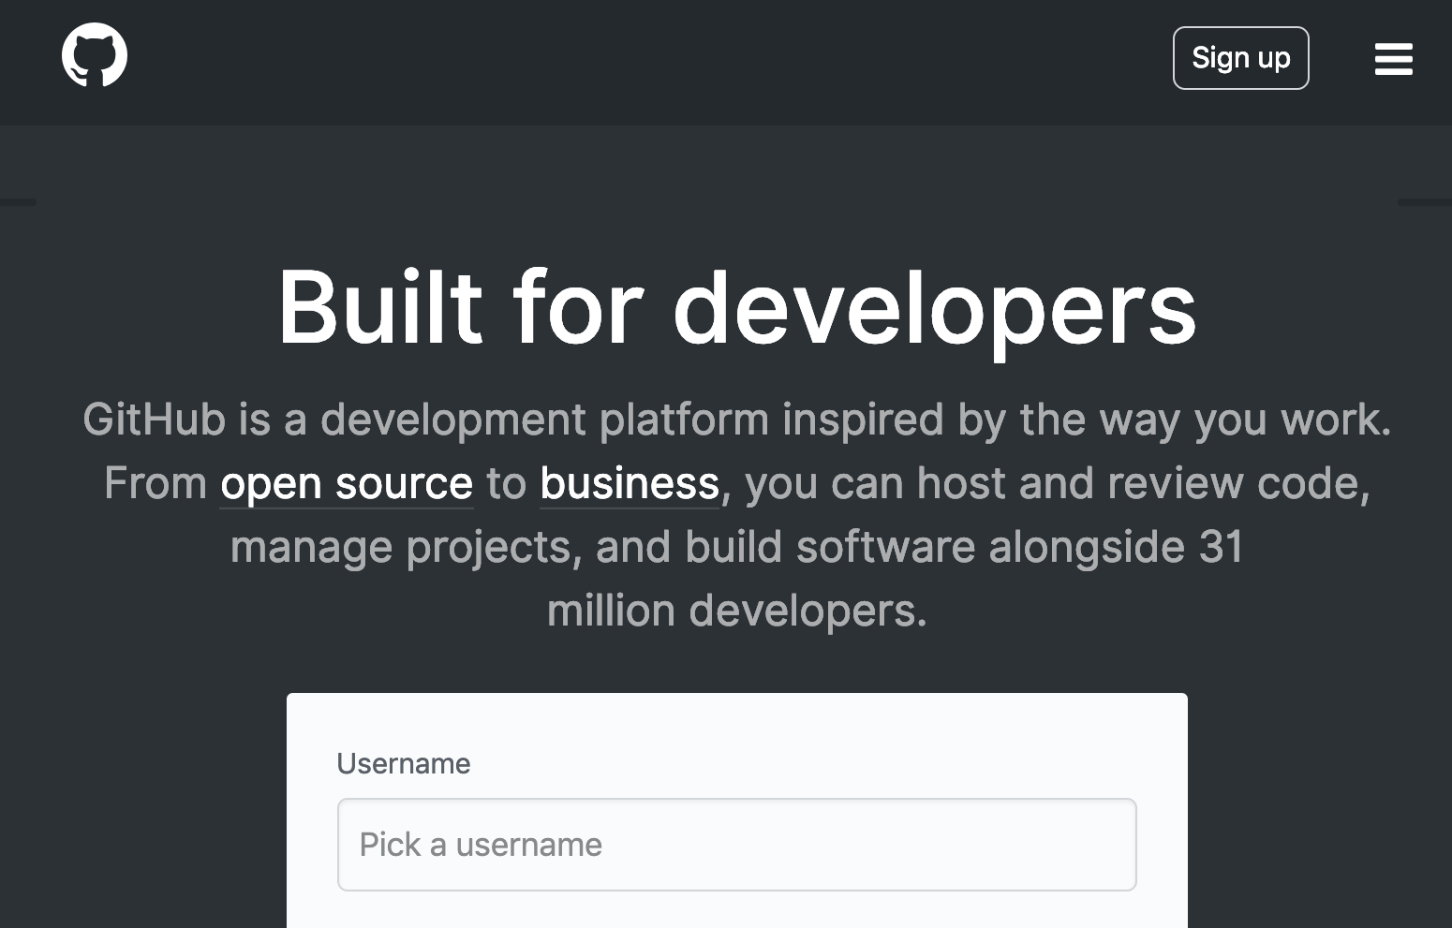
Let's make an account!
Visit the URL on the left if you're a student and on the right if you are not. Follow the instructions on GitHub.com to make your account!
https://education.github.com/
http://mlhlocal.host/github-signup

Slide 11
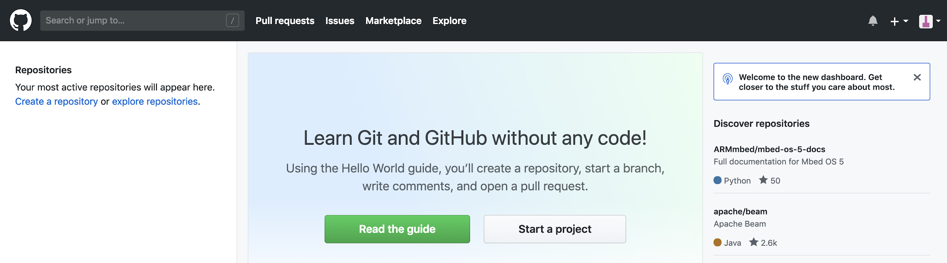
Explore GitHub
The GitHub platform provides numerous features for collaboration.
Next to the search bar, you can select Pull requests. This will show you your own pull requests against other people's repos.
Key Term
pull request: a way to ask to make changes to someone else's code by submitting your own changes for their review

Slide 12
Explore GitHub
The GitHub platform provides numerous features for collaboration.
Next to pull requests, you can see any issues you've opened or worked on.
Key Term
issues: a way to share a problem about someone else's code, without necessarily submitting your own solution

Slide 13
Explore GitHub
The GitHub platform provides numerous features for collaboration.
In the upper right hand corner, you can see any notifications you have received.
The + symbol allows you to create a new project.
Clicking your avatar opens the settings menu.

Slide 14
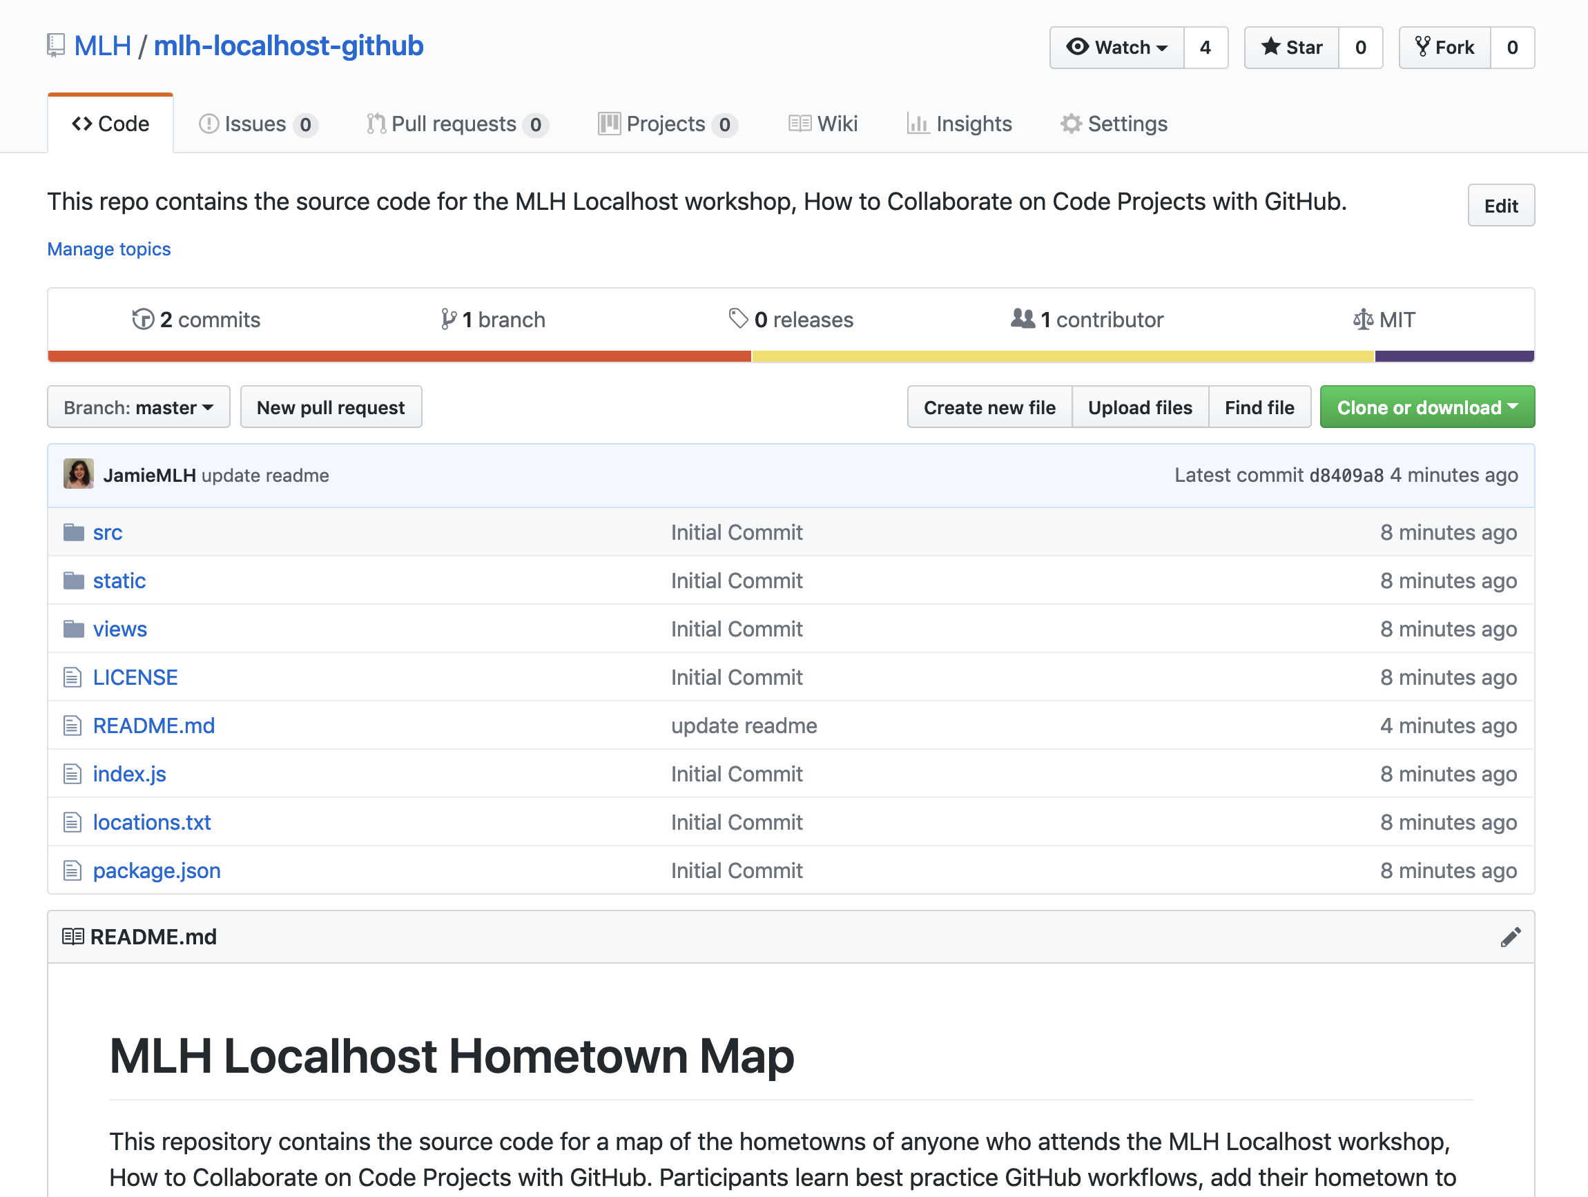
Explore a Repository
Navigate to the URL below and let's check out the repository for the map!
https://github.com/Jacob-s-unger
Key Term
repository: think of this like a project folder where code is stored!
Notes:
https://github.com/Jacob-s-unger

Slide 15
Explore a Repository
The first tab in a repository is the Code tab. It shows the code in the project.

Slide 16
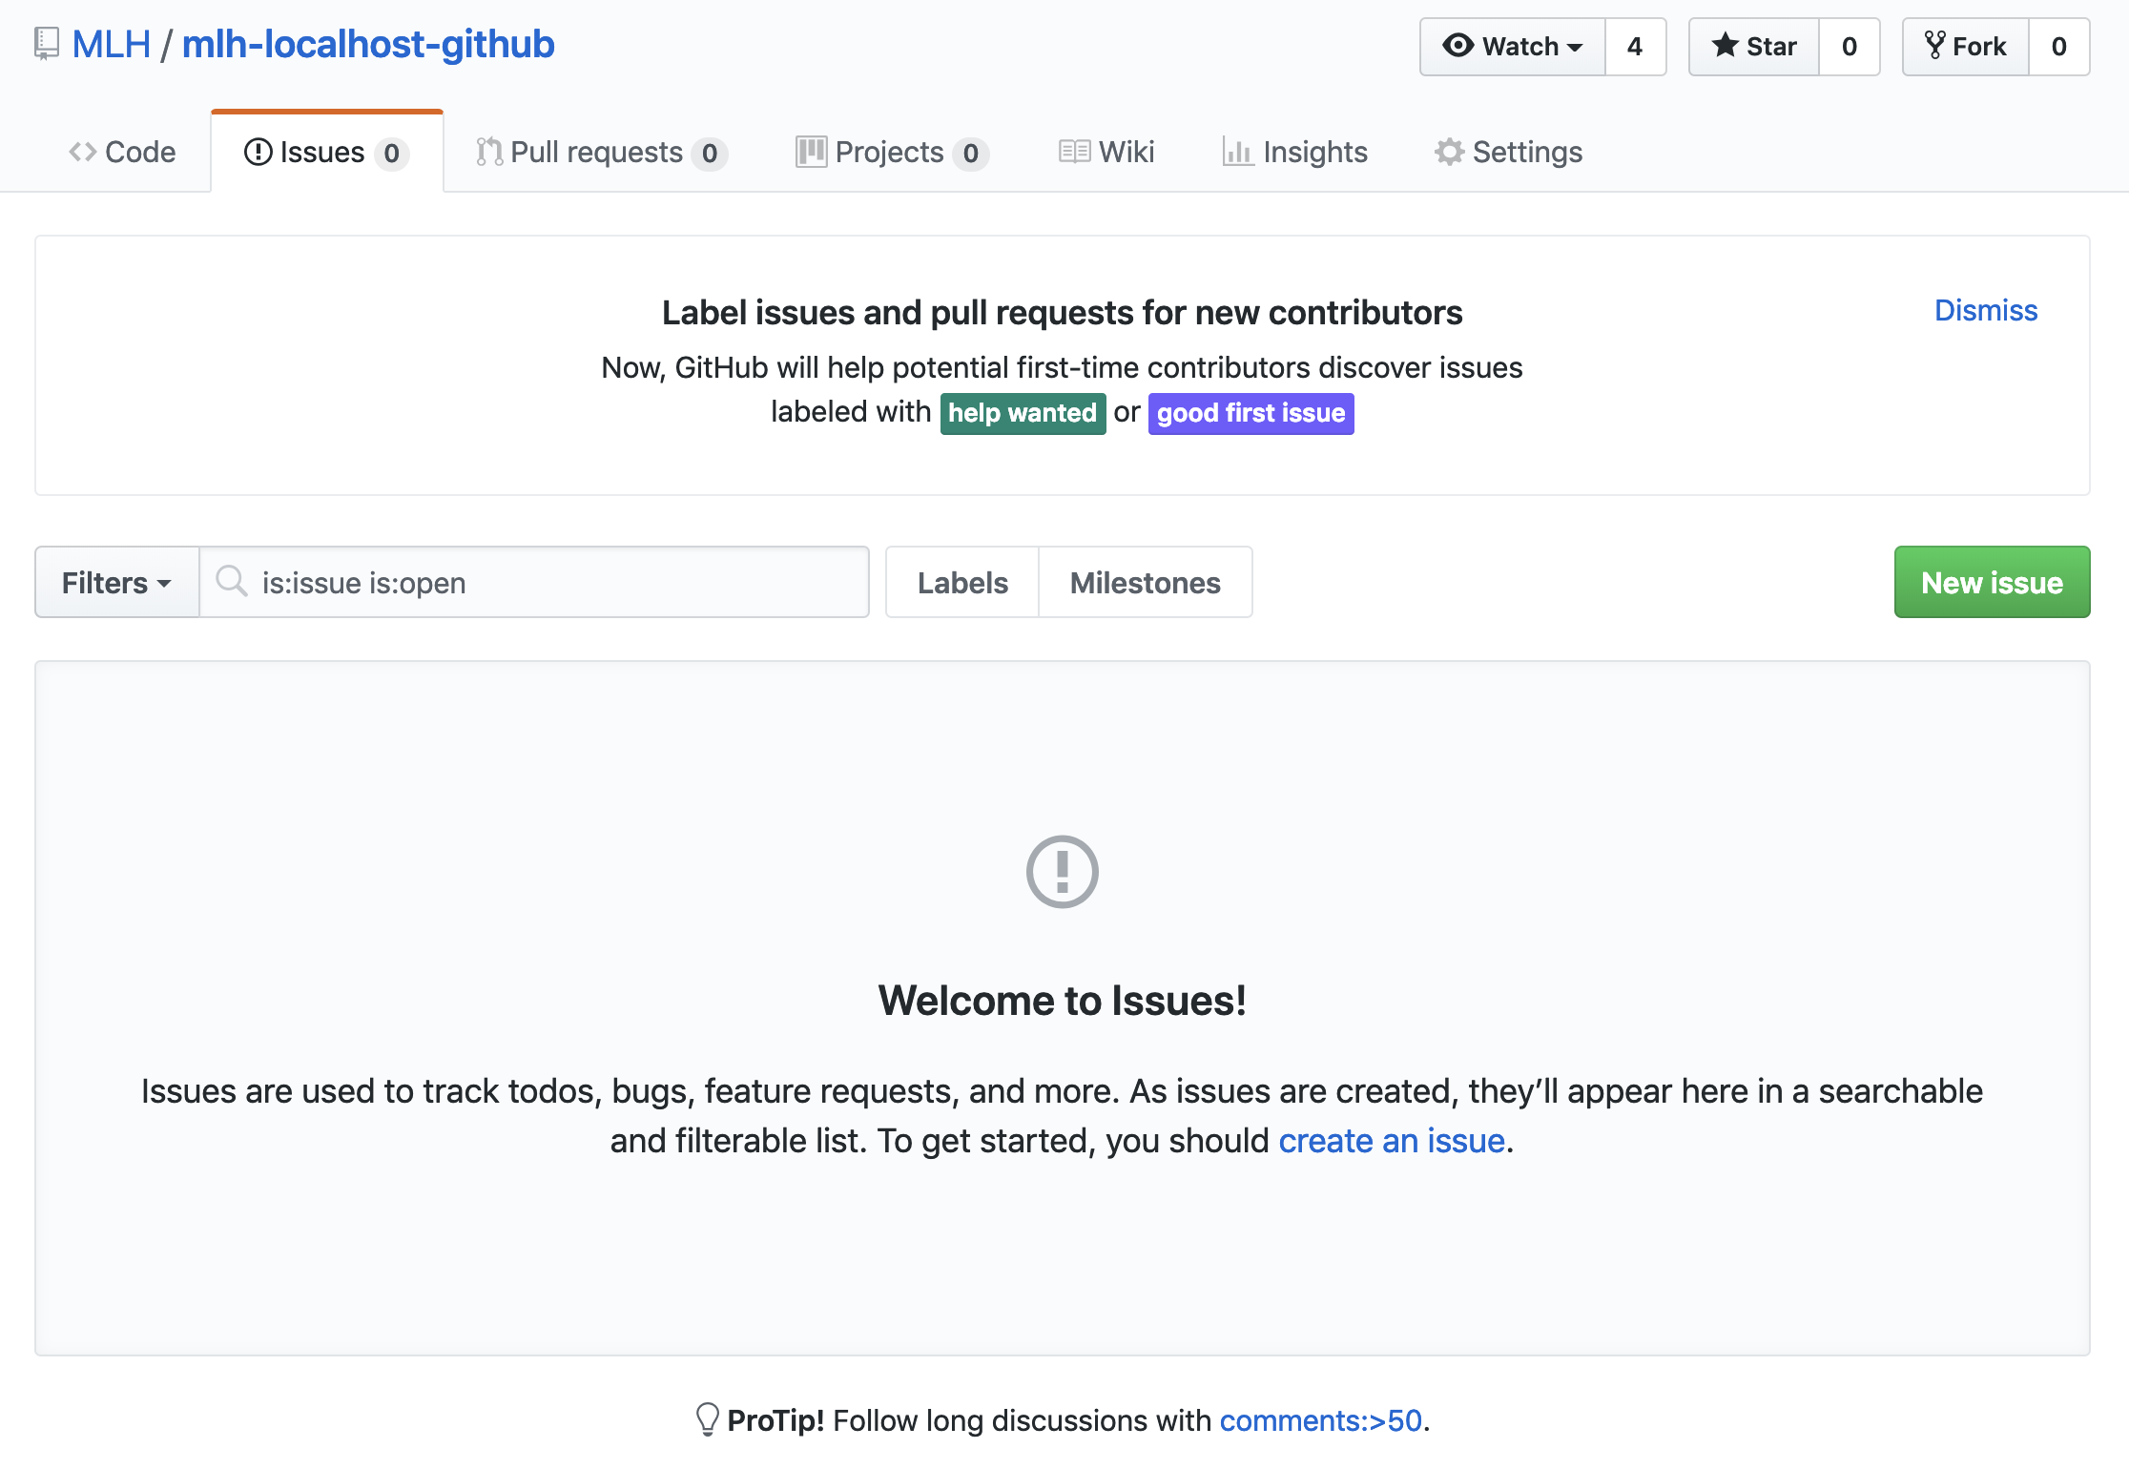
Explore a Repository
The second tab is the Issues tab. If there is a problem with the code in someone's project, you can open an Issue and let them know about it. Pro-tip: You should always follow the project maintainer's instructions for opening an issue.

Slide 17
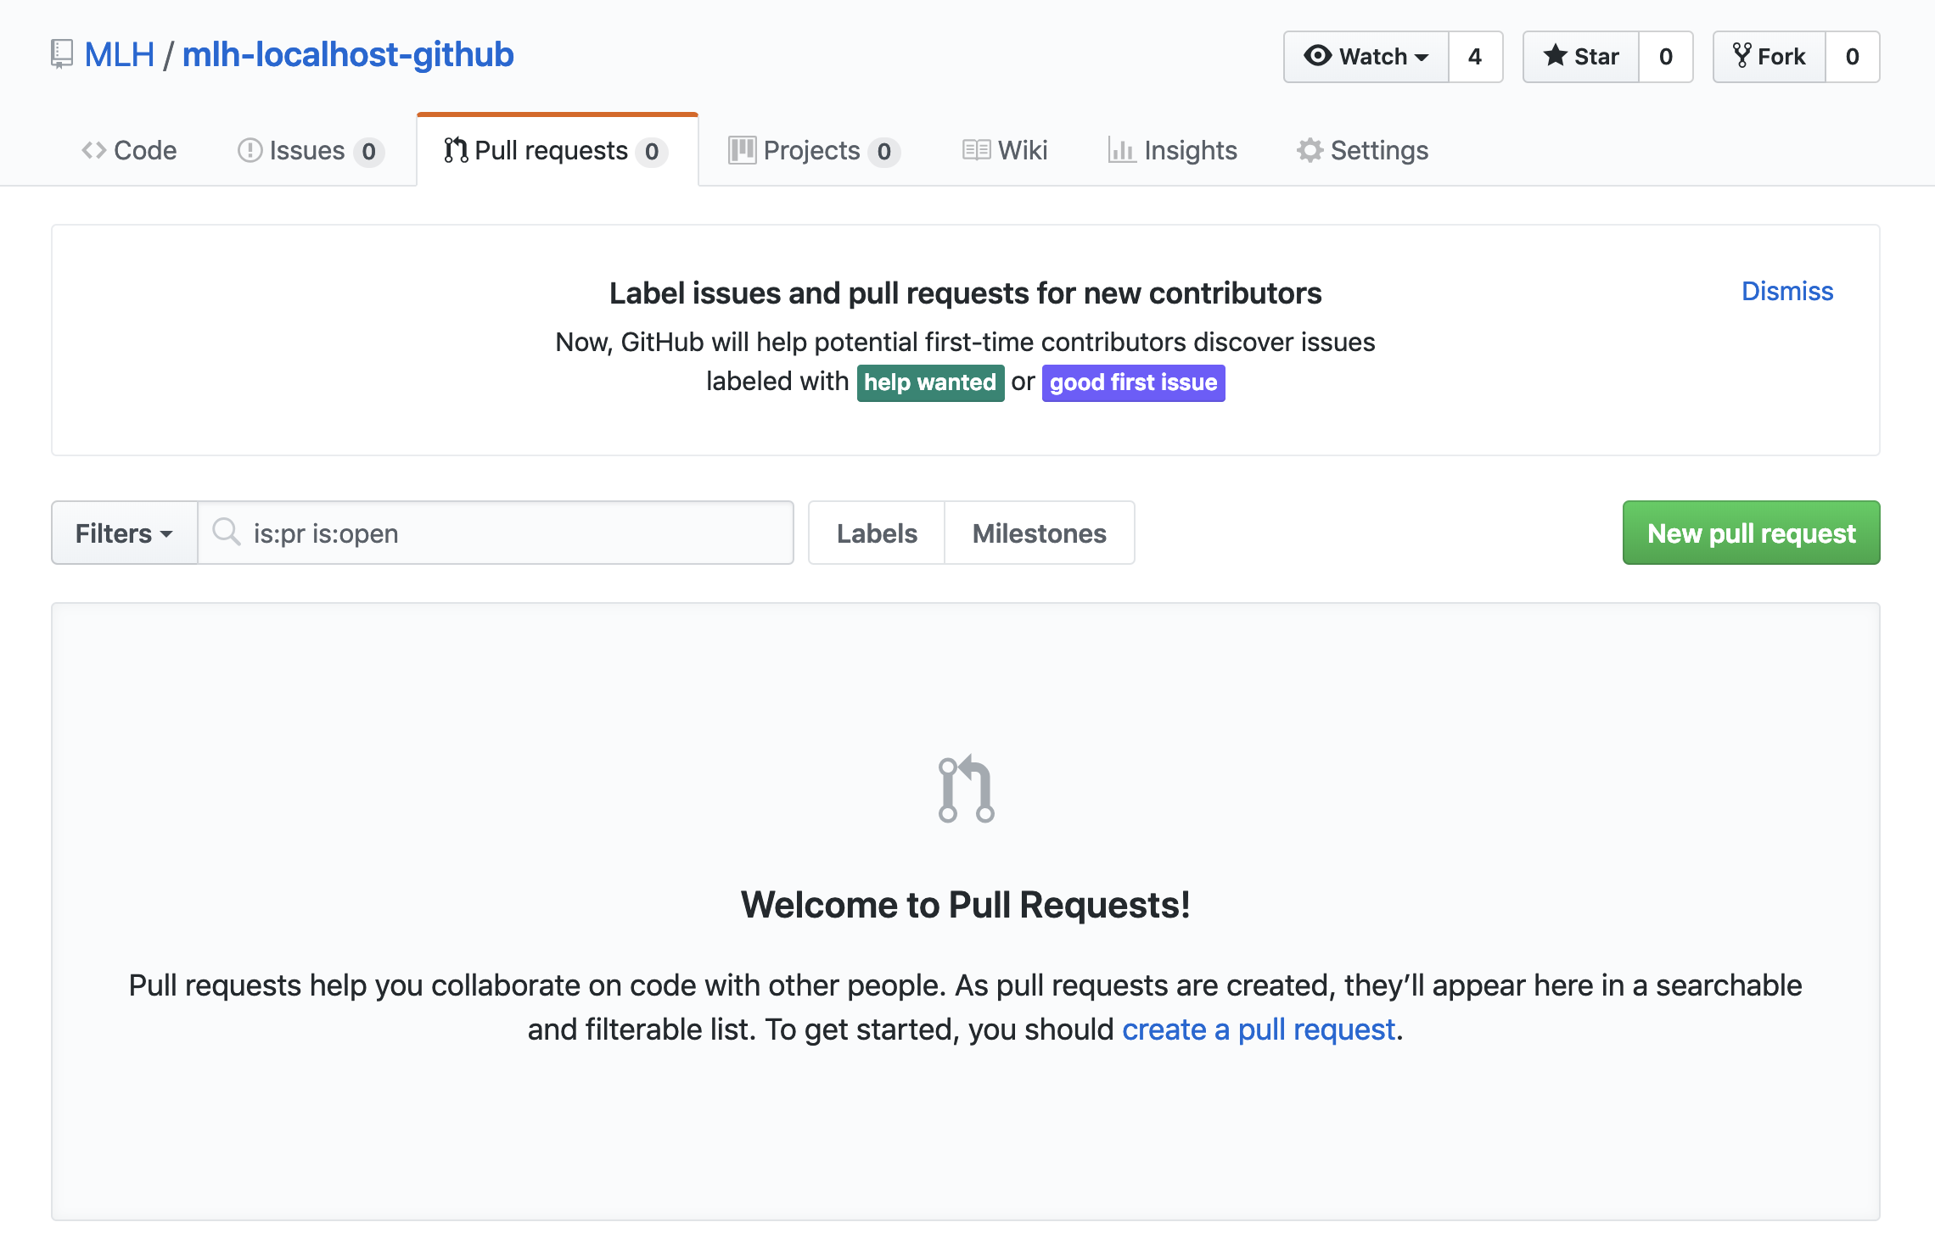
Explore a Repository
The third tab is the Pull Requests tab. If you want to contribute code to someone's repository, you'll open a Pull Request. You'll do that today!

Slide 18
There is a lot of terminology regarding Git and GitHub. Let's get started!

Slide 19
4.

Slide 20
Developer Workflow
You're going to practice a typical best practice developer workflow.
First, you'll fork someone else's code. This means creating your own copy of it.
Then you'll create a branch. The branch is a parallel version of your copy, where you'll test your own changes.
Key Terms
fork: your own copy of someone else's repository.
branch: a parallel version of the master copy of a repo. Making a branch allows you to edit code without accidentally breaking a working version

Slide 21
Developer Workflow
You stage your changes as you go. When you're happy with them, you'll commit them.
If you want to add your code to someone else's project, you'll open a pull request.
If they approve it, they'll merge your branch into their master branch.
Key Terms
stage: add to a cohesive group/bundle of revisions
commit: a group of revisions you want to officially add to your branch
merge: to officially add the changes from your branch into the master branch (or another branch)

Slide 22
Great! That's it. That's how you work with Git. Let's try it using GitHub!

Slide 23
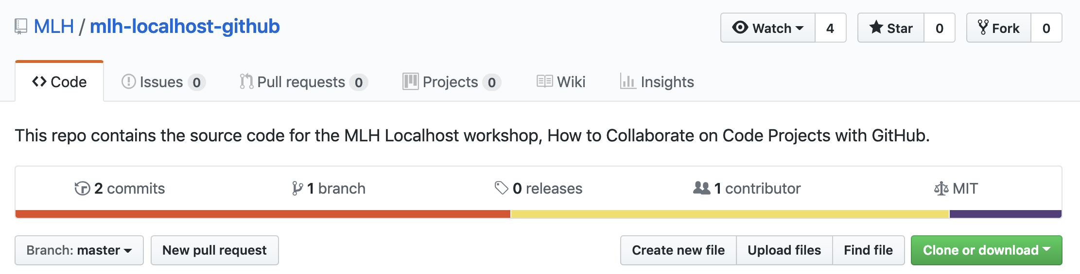
Network Activity Workflow
As you can see, there are so many way to use GitHub! Today we're going to use a very common developer workflow.
Fork the repository you want to contribute to.
Note: This is only necessary if you are not a Collaborator on the project.

Slide 24
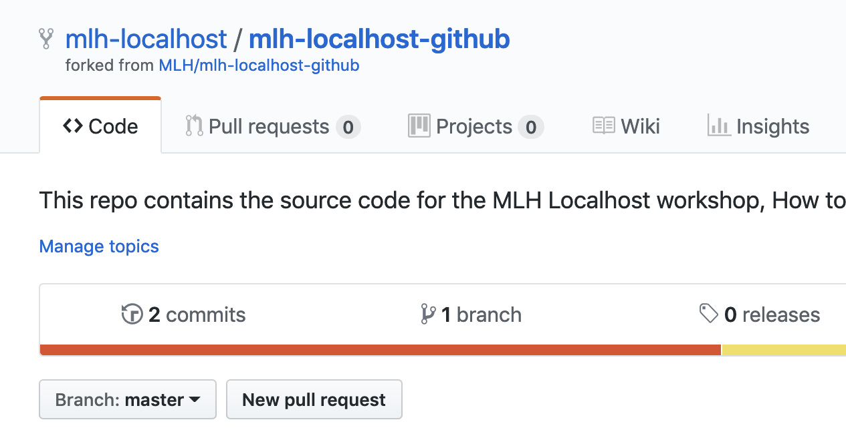
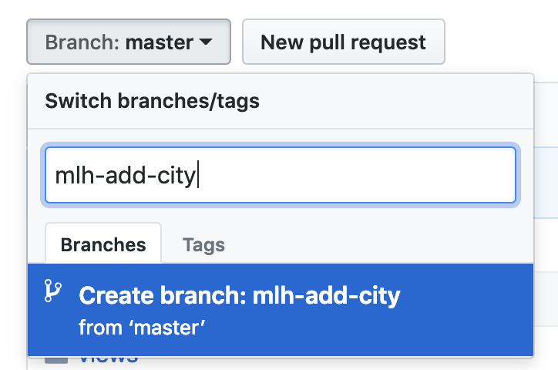
Network Activity Workflow
Create a branch. You should always try to name branches with your name and what you're doing, or follow the conventions set by your team.

Slide 25
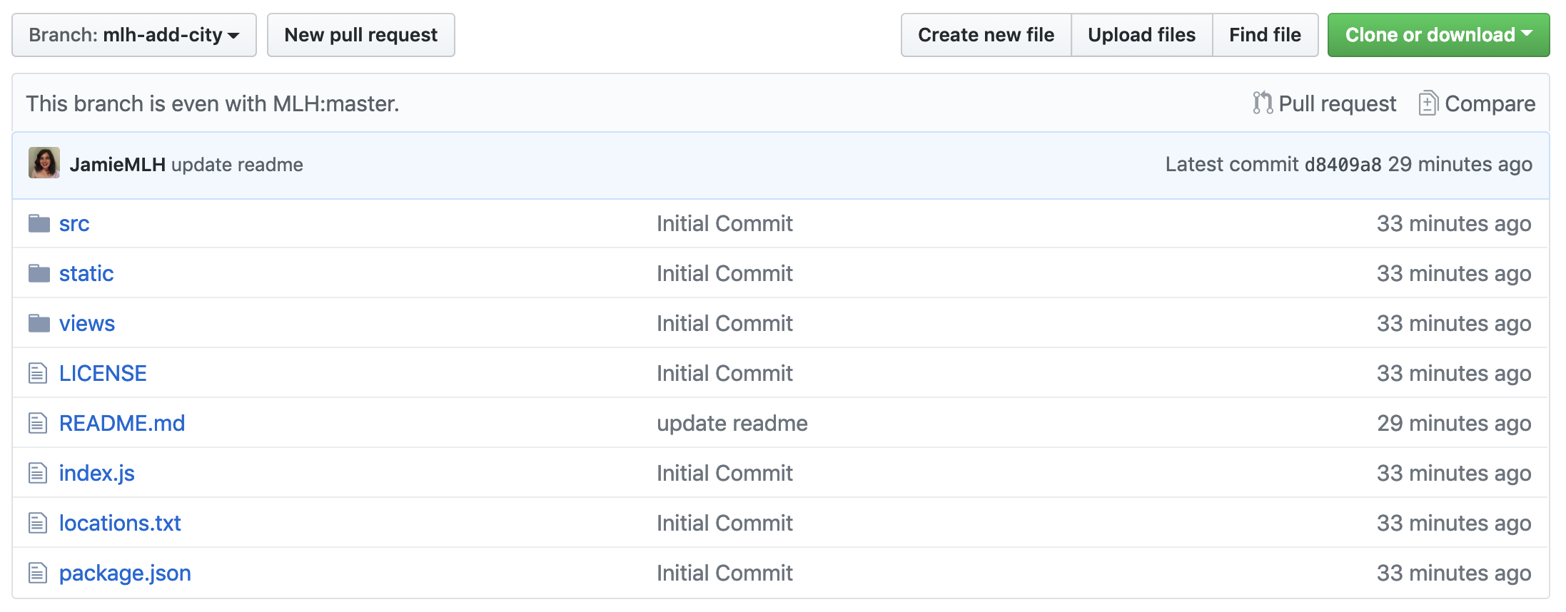
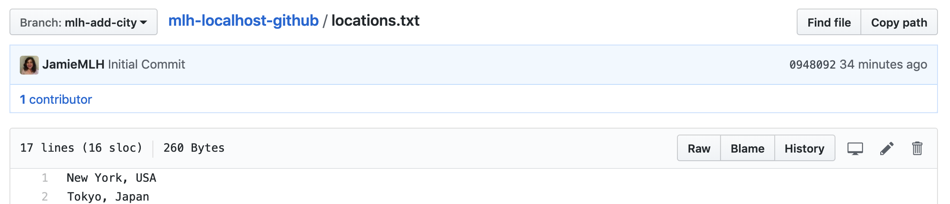
Developer Workflow
Open locations.txt.
Select the edit icon. It looks like a pencil.

Slide 26
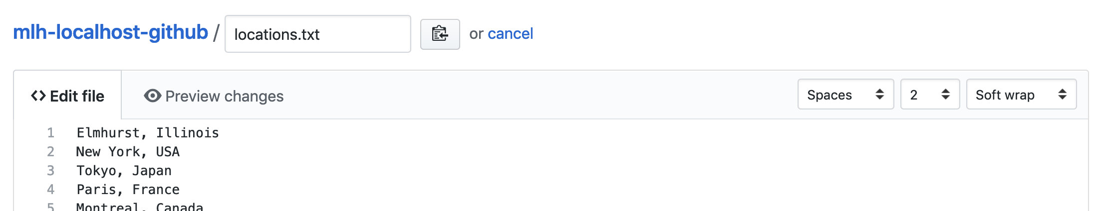
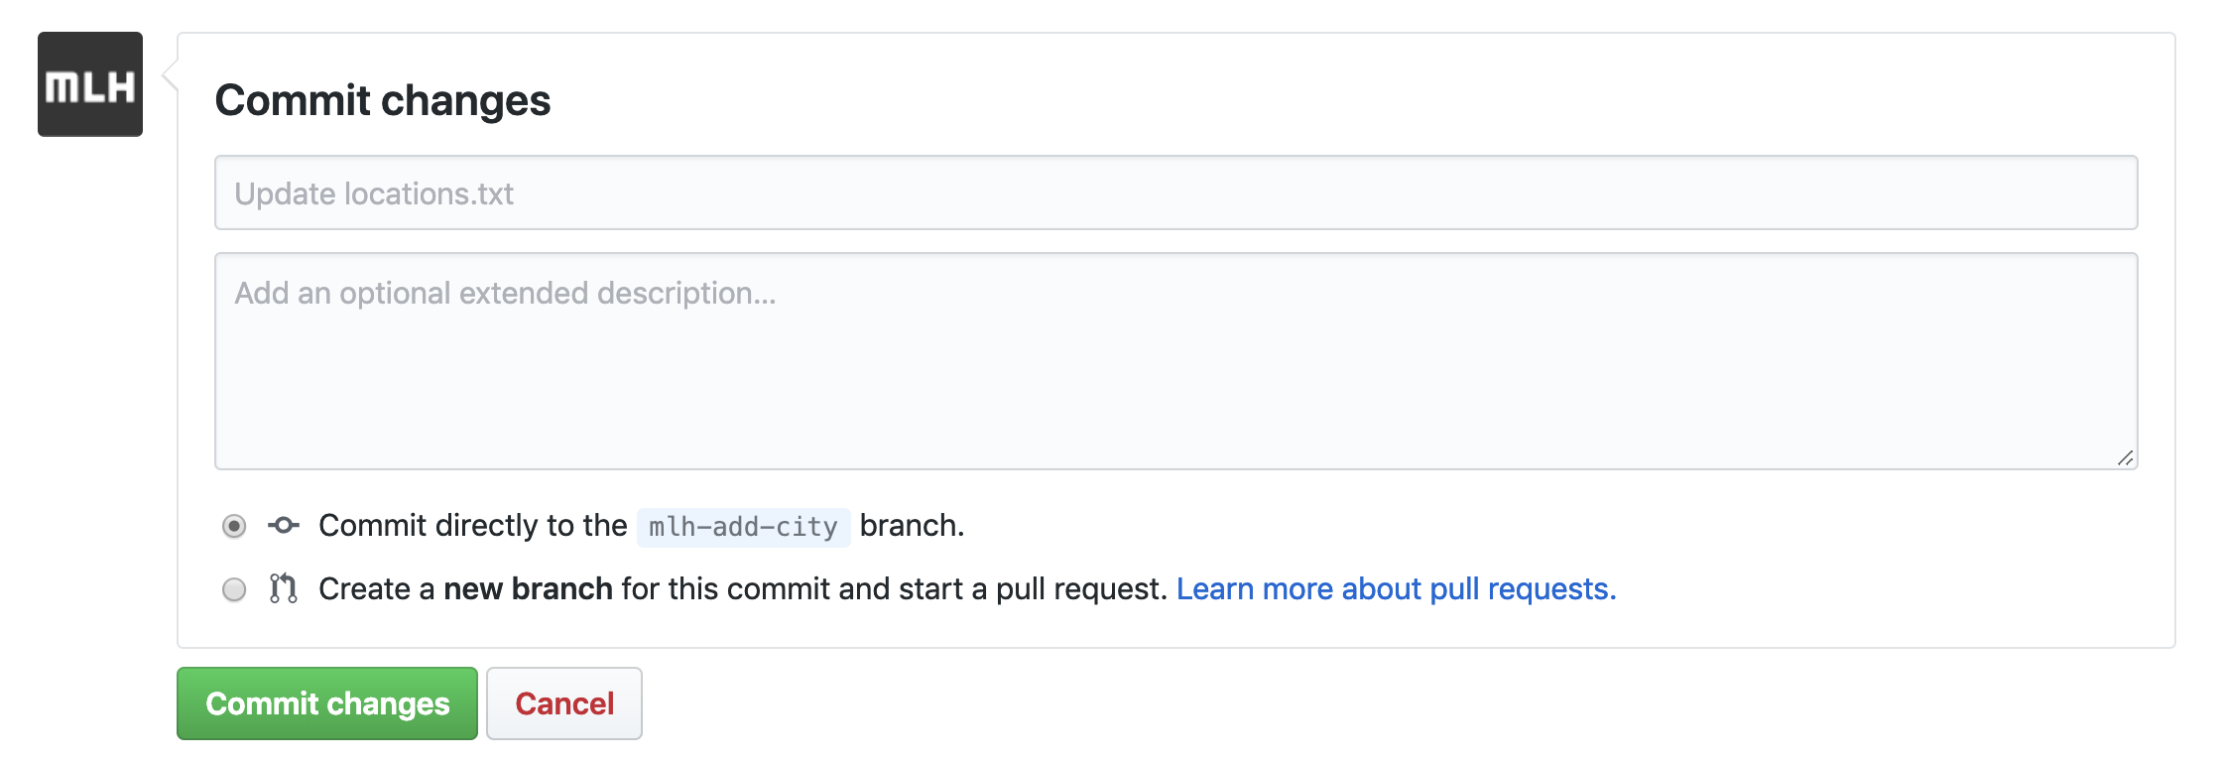
Network Activity Workflow
Add the name of your hometown. Choose a random blank line!
Scroll to the bottom to the Commit changes section.

Slide 27
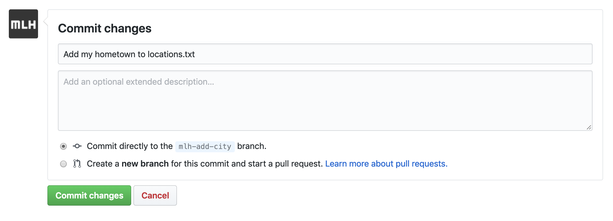
Network Activity Workflow
Add a descriptive message. Select Commit changes.

Slide 28
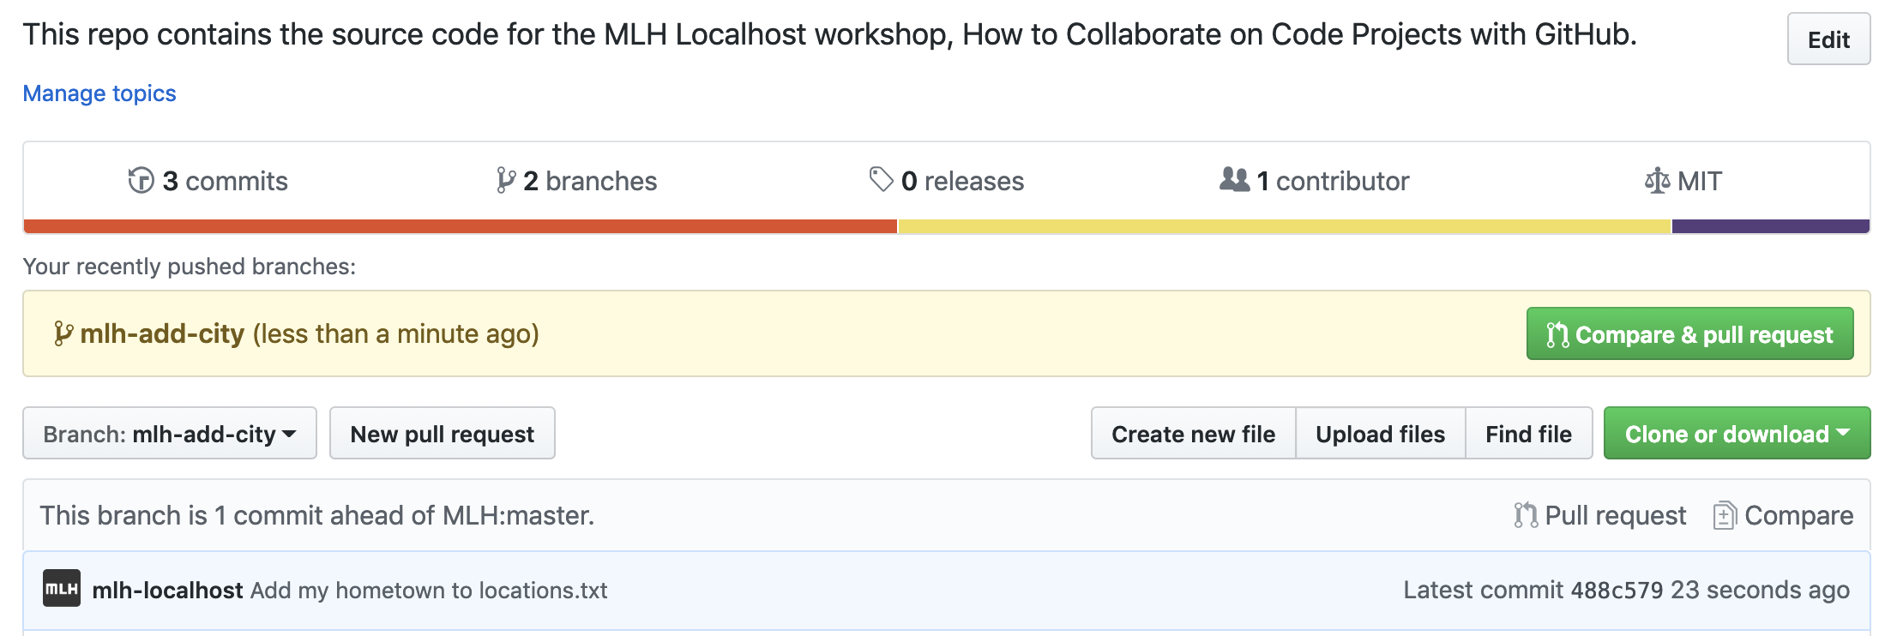
Network Activity Workflow
Return to the main page of your repo.
Select Pull request.
Notes:
Gets a little bit trickier here because of Github’s new UI, but under the pull requests tab, on the right third of the screen you will see a button that says “Create Pull Request”, then you’ll have to make sure that you are comparing the right branches for the pull!

Slide 29
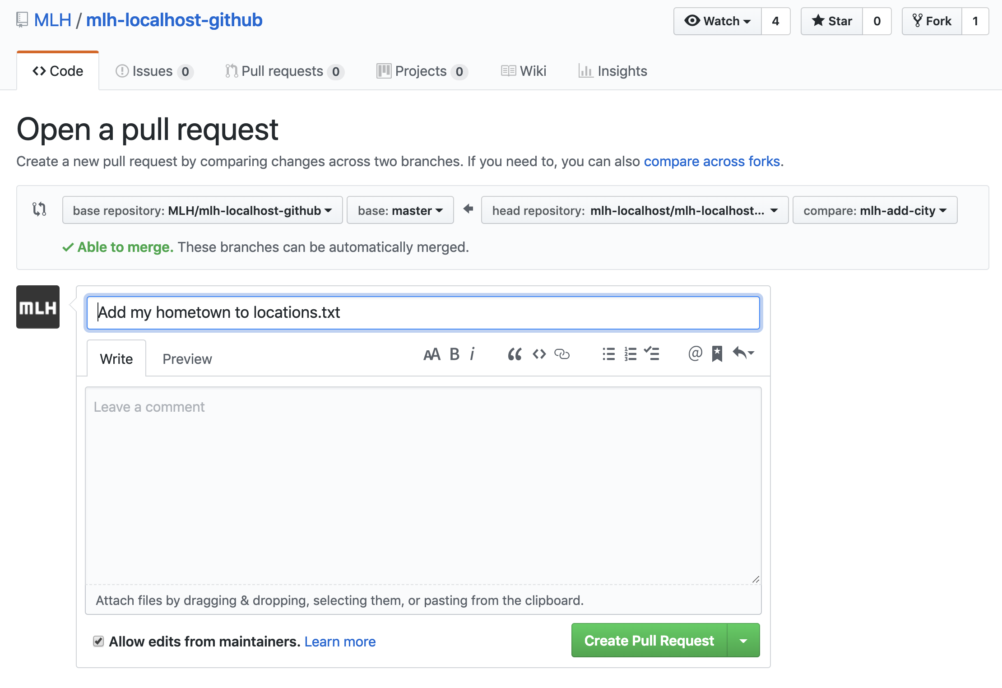
Network Activity Workflow
Because this is a simple pull request, you can simply select Create Pull Request. If you were contributing to an open source project, you would want to be very descriptive about the changes you made.

Slide 30
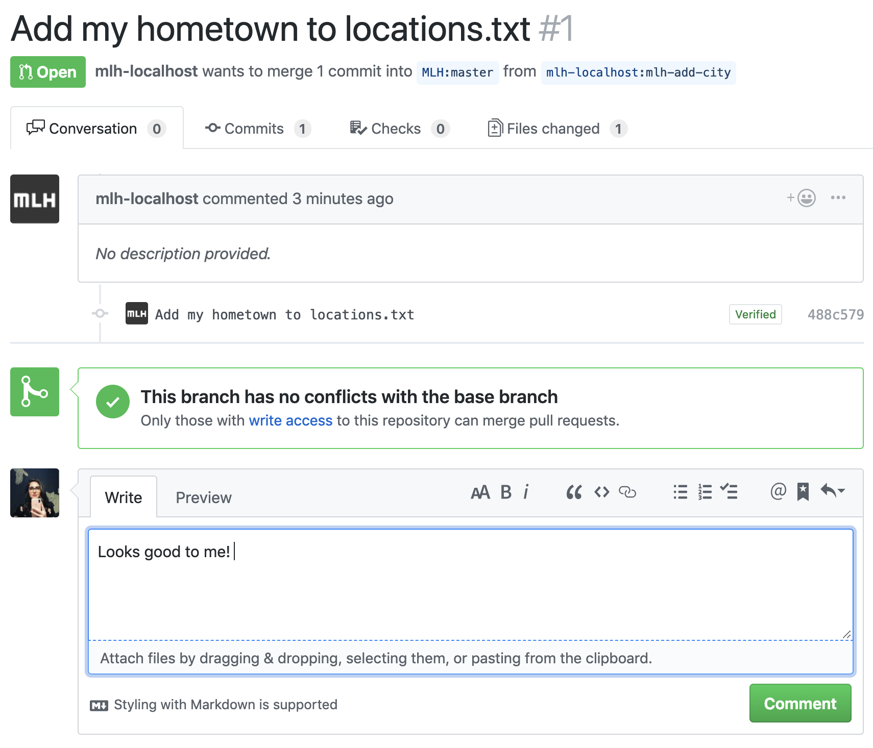
Network Activity Workflow
Ask someone else to comment on your PR. Comment on someone else's PR, too! You can find other pull requests by selecting the Pull requests tab on the repo's home page.

Slide 31
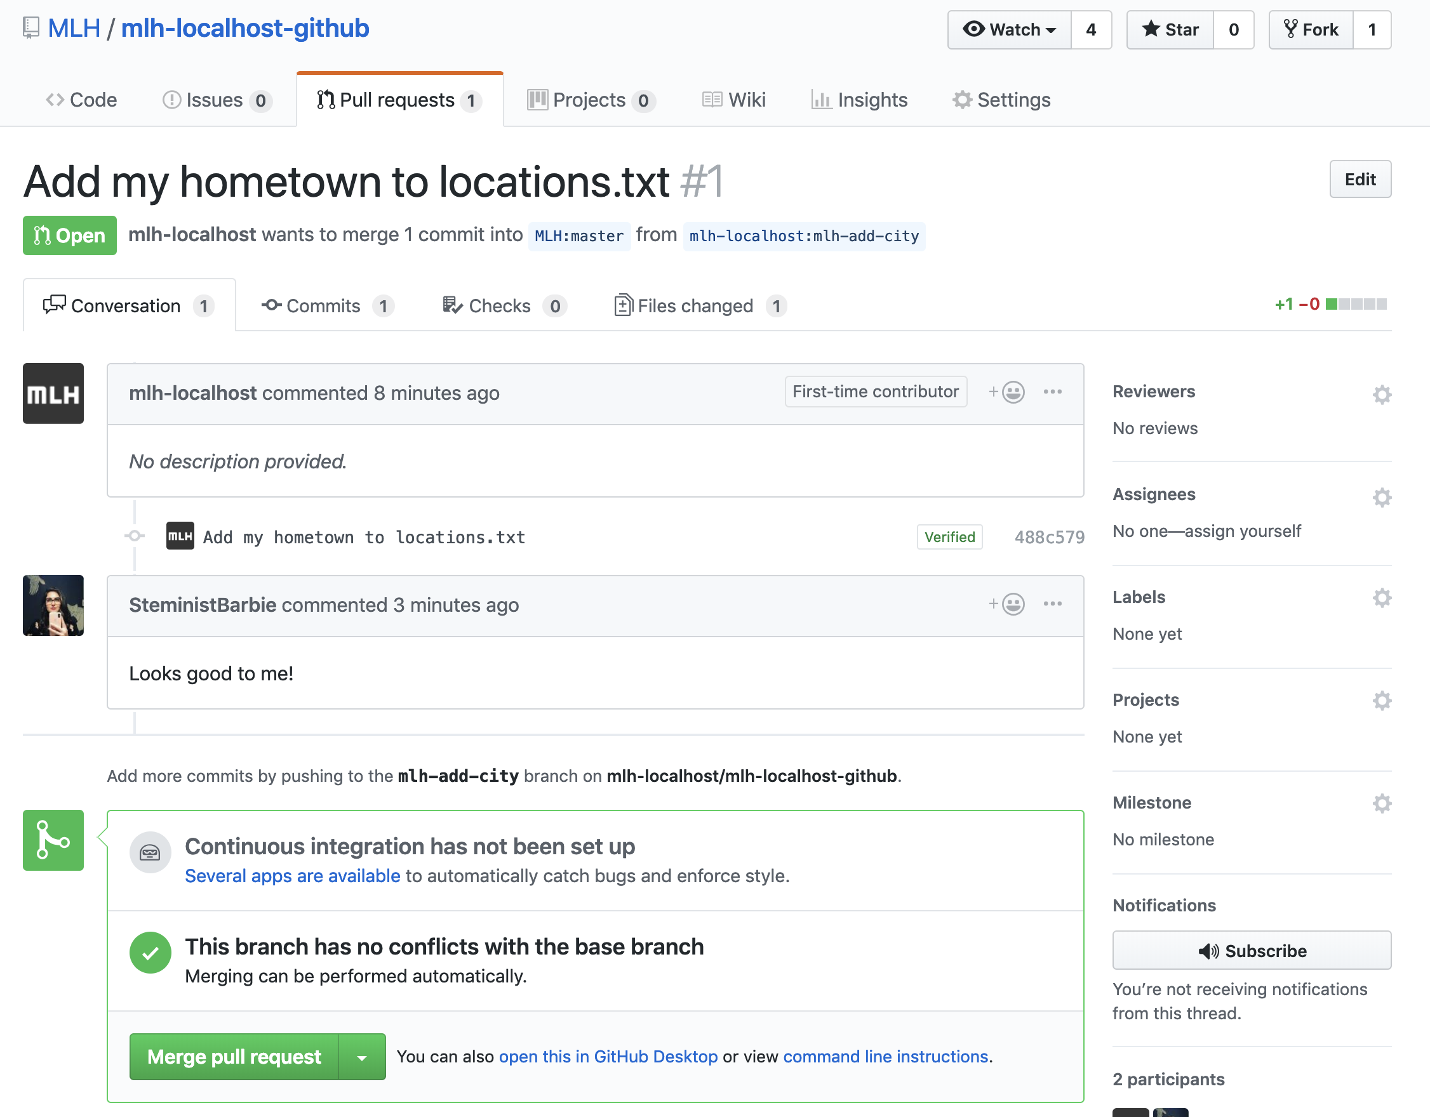
Network Activity Workflow
This is what a pull request looks like for someone who has Write access to a repo. The organizer of this workshop will click Merge pull request, and your hometown will be added!

Slide 32
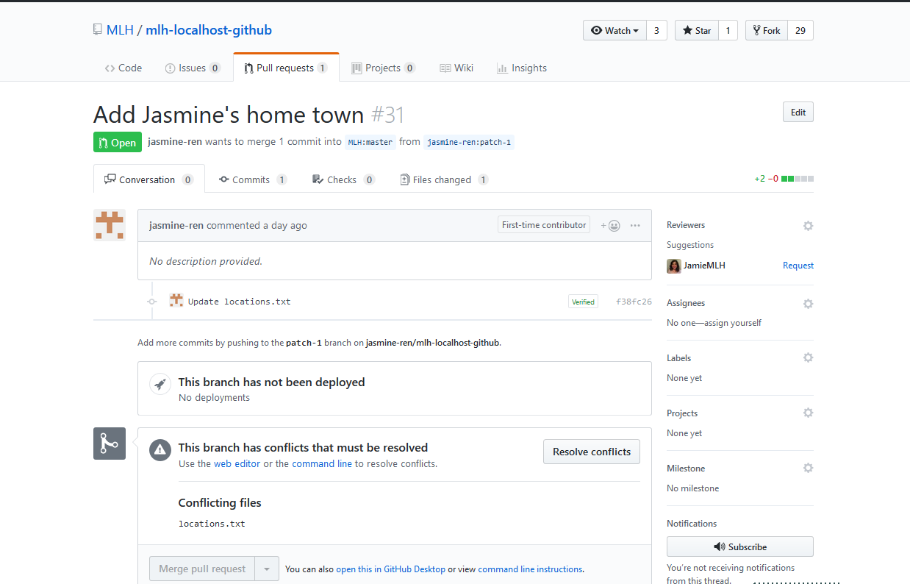
Conflict Resolution
When a file has multiple edits, it can be unclear which change should be committed. This is a conflict and must be resolved before merging.

Slide 33
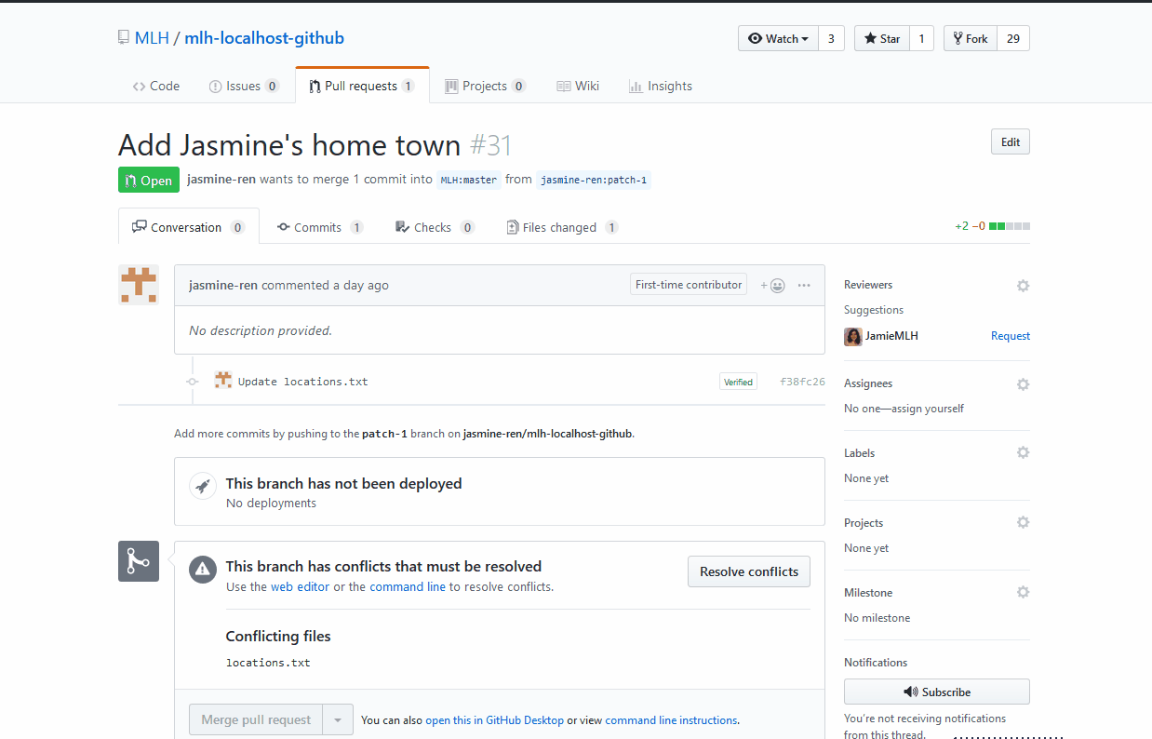
Conflict Resolution
A conflict is marked by
<<<<<<< new branch
changes
=======
original >>>>>>> original-branch
Edit the file to the desired state, mark it resolved and then merge it.
Notes:
In the gif, there is no text being replaced, so there’s no “original”.
You can ask for a volunteer to come up and help resolve conflicts. This might also be a good time to take break so you can resolve all the conflicts.

Slide 34
Network Activity Workflow
Refresh the original webpage and wait for more people's hometowns to be added! Note: this web site is set up to auto-deploy when new code is merged to the repository, but it can take a few minutes.

Slide 35
Amazing! Now you know how to work with GitHub in the browser. The next section will teach you how to use GitHub on the command line on your computer!

Slide 36
4.

Slide 37
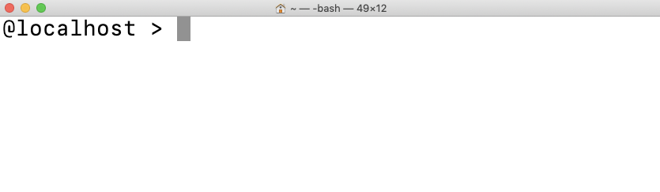
GitHub From the Command Line
Once you start working on projects that are more complex, you might find that you prefer using your own local coding environment with GitHub. Let's learn how to set that up! We'll also learn how our local environment works with our repos on GitHub.

Slide 38
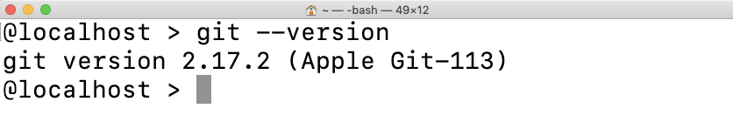
Install Git
First, let's see if you have Git already installed on your computer. Type the command below in Terminal, PowerShell, or any terminal application. If you already have git installed, you can skip the next few slides!

Slide 39
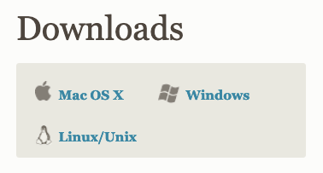
Install Git
https://git-scm.com/downloads
If you do not have git installed, navigate to the URL above.
Select your operating system and the installer will download.
Notes:
Bathroom Break Opportunity

Slide 40
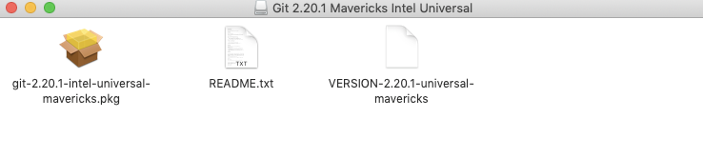
Install Git: MacOS
Open the installer and follow the instructions. It should be fine to select all of the default options.

Slide 41
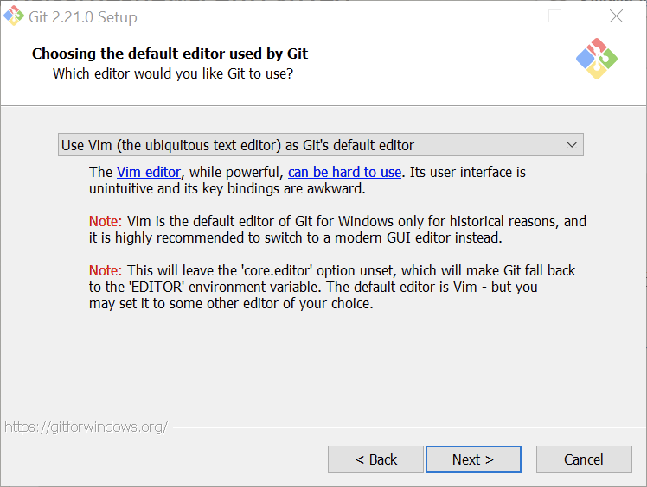
Install Git: Windows
Open the installer and follow the instructions. It should be fine to select all of the default options, except for the one below. We recommend choosing your preferred text editor in this step.

Slide 42
Install Git
Restart your terminal, PowerShell, or Git Bash.
Run the command below again. Raise your hand if this is not what you see.

Slide 43
Great! Now you have Git installed. Let's connect your local environment with your GitHub account.

Slide 44
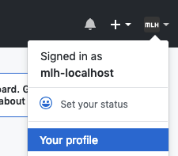
Configure Git
We want to configure our local environments so that the correct GitHub account is associated with our commits.
On GitHub, find your user name. You can find it by clicking your avatar in the upper right hand corner. It will say "Signed in as"

Slide 45
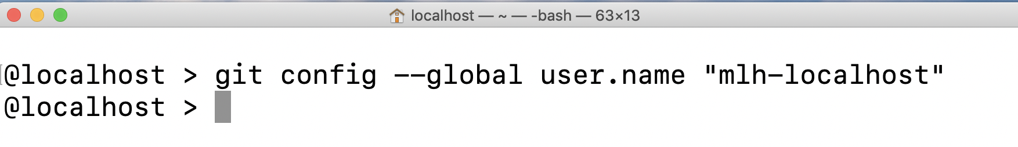
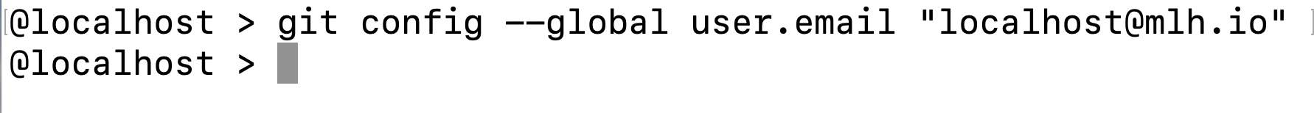
Configure Git
Return to your command line or terminal. Replace mlh-localhost with your username.
Use the command below to configure your email address as well.
Notes:
Note: You should have no return in the terminal, that means it worked!

Slide 46
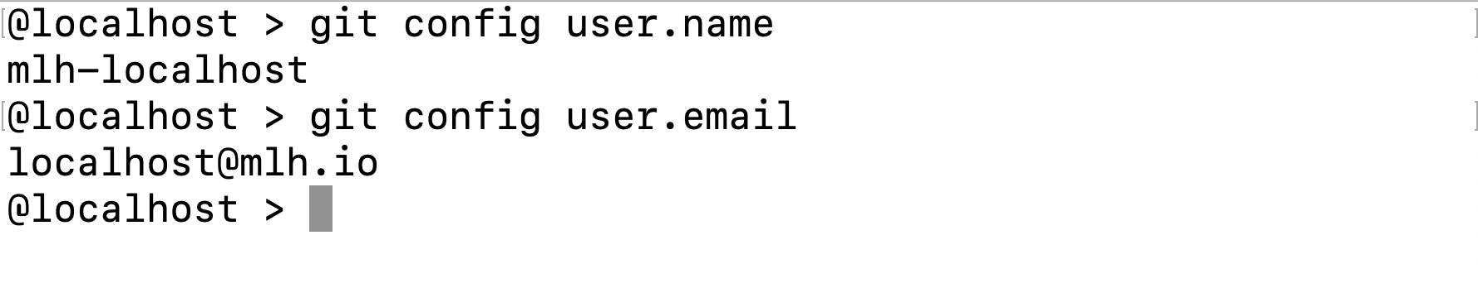
Configure Git
You can use the two commands below to double check that you've set this up.

Slide 47
Now, let's cover some useful commands.

Slide 48
Individual Workflow
The workflow from the command line has a few added steps compared to using GitHub.
You can clone any repository you have access to using git clone.
Then, you create a branch with git branch "name-of-branch".
After you make changes, you'll use git add to stage your changes.
Key Terms
clone: to copy a repository to your computer
stage: saving your changes so they are ready to be added to your branch
Notes:
GitHub combines some commands to make things less confusing.
Git is really complicated. It takes years to learn completely. However, you can be competent enough to Get Things Done with a few commands.

Slide 49
Individual Workflow
The workflow from the command line has a few added steps compared to using GitHub.
You'll use git commit -m "explain your changes" to add changes to your branch.
When you're ready to push your local changes to your repository on GitHub, you'll use git push.
Command Explanation
-m is a flag for message. That means that whatever comes after -m is a message explaining your commit. Your commit message doesn't have any effect on your code; it's like a comment.
Key Terms
push: add the changes on your computer to your GitHub repository.
Notes:
GitHub combines some commands to make things less confusing.
Git is really complicated. It takes years to learn completely. However, you can be competent enough to Get Things Done with a few commands.

Slide 50
Individual Workflow
The workflow from the command line has a few added steps compared to using GitHub.
You can make a pull request and have your PR merged on GitHub like before.
You can pull changes from GitHub to your local repository.
Key Terms
pull: Bring changes from GitHub down to your local copy.
Notes:
GitHub combines some commands to make things less confusing.
Git is really complicated. It takes years to learn completely. However, you can be competent enough to Get Things Done with a few commands.

Slide 51
You might feel a little confused by committing, staging, and pushing your changes. Let's explore a visual representation!

Slide 52

Three phases of Git
There are three main phases of Git. You can think of these like a work desk!
Working directory
Where the writing happens. This is when you are coding and saving your work.
Staging area
When you are happy with a group of changes and use git add, you are staging your changes. These are like called commits, and they are like rough drafts stored in a bundle.
Repository
When you are happy with your commits, you commit them to the repository. These are like final drafts stored more permanently in a drawer
Notes:
The three phases of git can be thought of as a typical desk setup. You move from writing without version control, to making a bundle of changes and then permanently storing those changes in a repository.

Slide 53
Here's another visual representation of what you just saw.

Slide 54



Three phases of Git
Use the staging area to build a commit
Repository Final draft, permanent
git commit
Staging Area Your rough draft
git add
Working Directory Your workspace, local on your machine
Notes:
The commands, git add and git commit are how changes moves between stages. Imagine your “trimming the fat” as you move up the pyramid, getting closer to a final verison

Slide 55
Great! Let's try it.

Slide 56
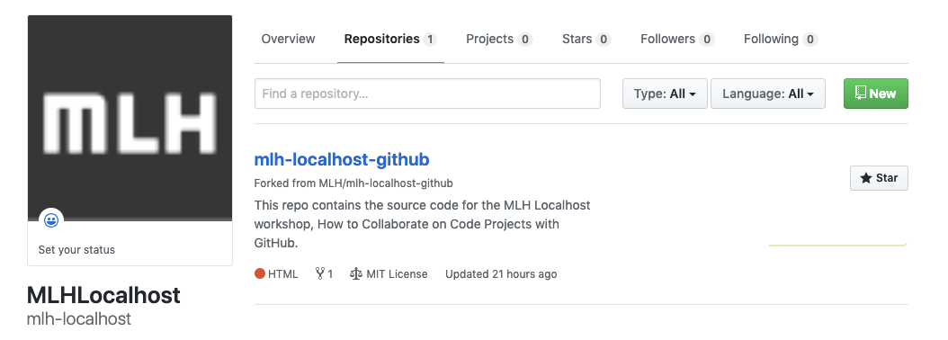
Create a Repo
Let's create a new repository on GitHub and work with it locally.
From your profile or homepage on GitHub, click New.

Slide 57
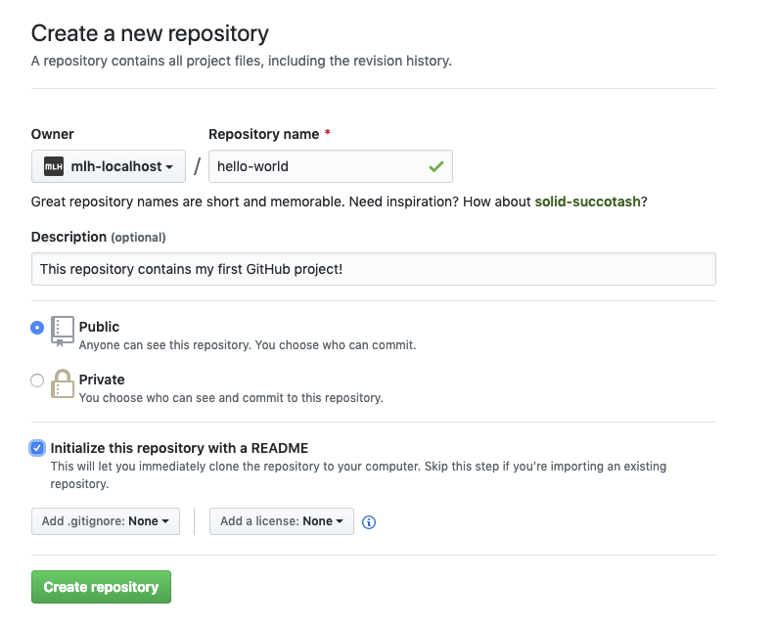
Create a Repo
Name your repository (repo) whatever you want! We chose hello-world.
Write a sentence describing your repo.
Select Initialize this repository with a README.

Slide 58
Create a Repo
If this were a code project, you would usually add a .gitignore and/or a license but you don't need to.
Click Create repository.

Slide 59
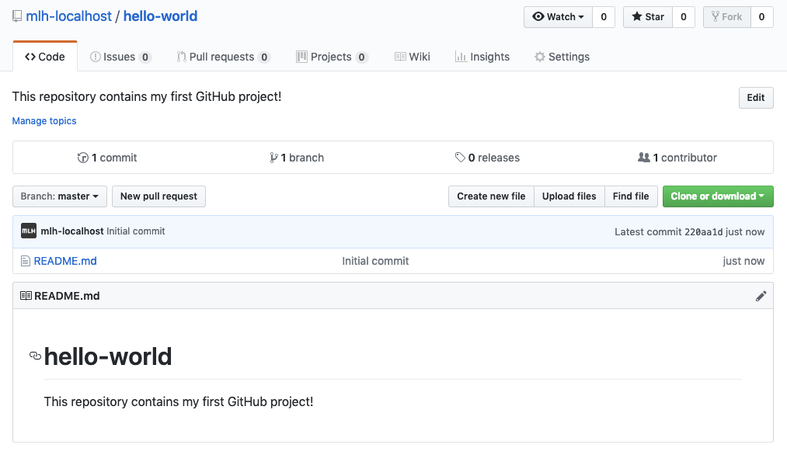
Create a Repo
You will be redirected to the homepage for your new repository!

Slide 60
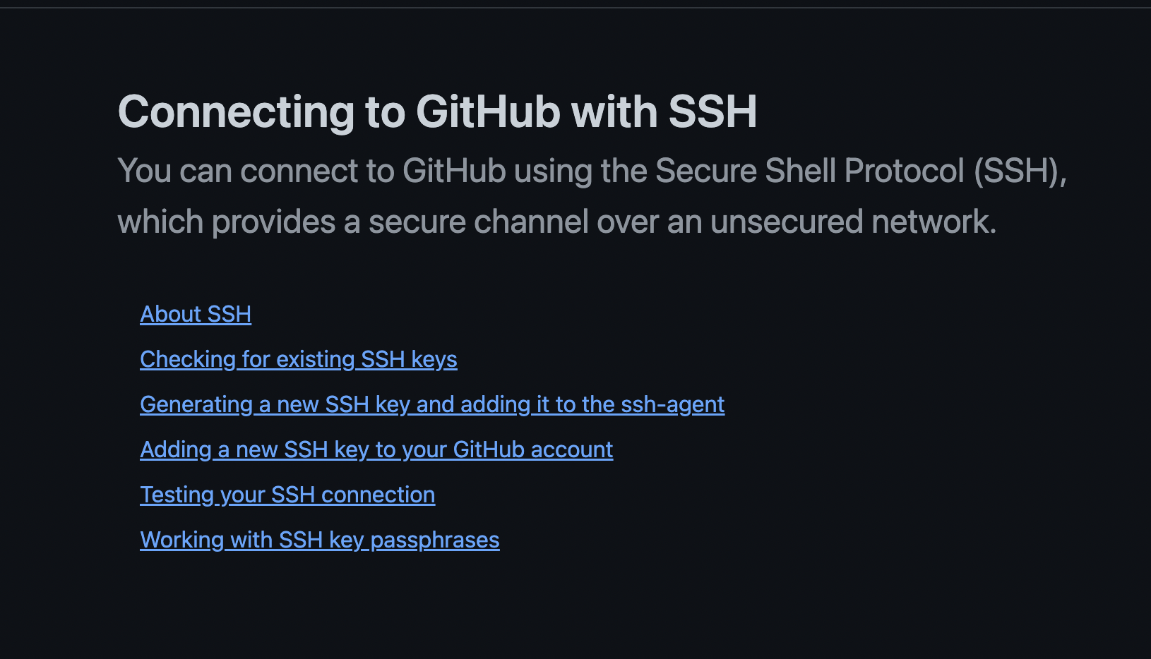
Fun with SSH Keys!
To make accessing your Github repository’s secure and so that you don’t have to enter a password/PIT everytime, we will set up SSH key access!
https://docs.github.com/en/authentication/connecting-to-github-with-ssh
Notes:
20 Minutes of students working on it, walk around to help!

Slide 61
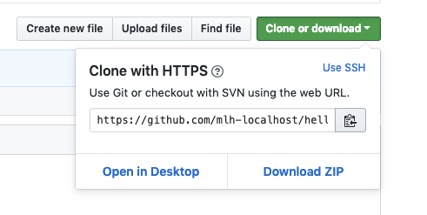
Clone Your Repo
Click Clone or download.
Then click the clipboard symbol to copy the address of your repo.

Slide 62
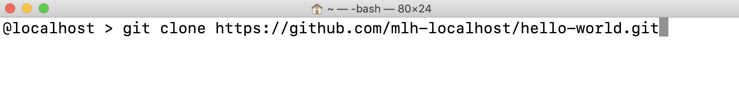
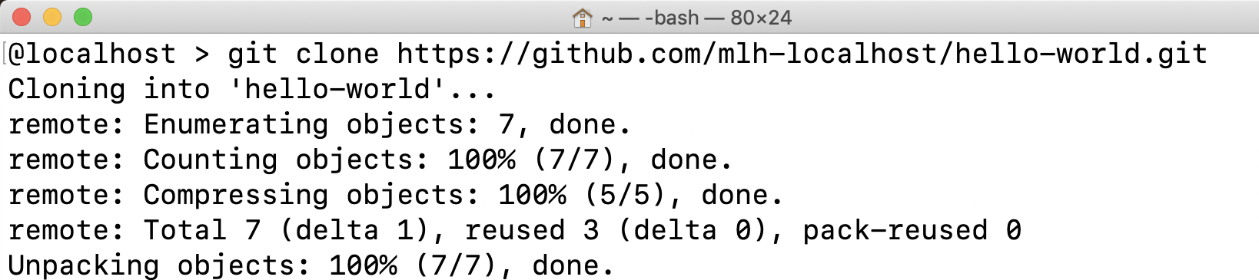
Clone Your Repo
Back in the terminal, type git clone then paste the address of your repo.
You will see output like this:

Slide 63
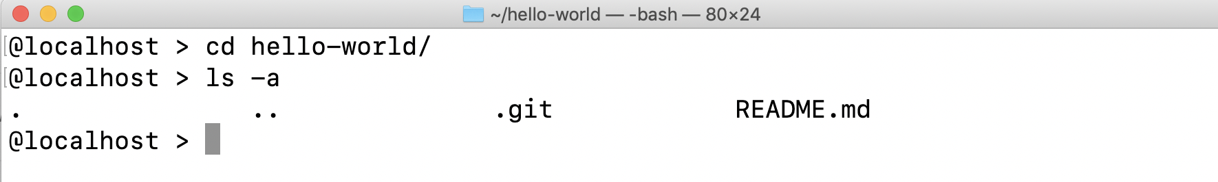
Explore Your Repo
It's important to note that you did not simply download the code. You cloned a Git repo. A git repo comes with a special folder called .git. You don't need to know a lot about this folder. Just keep in mind that it connects your local project to the project on GitHub.

Slide 64
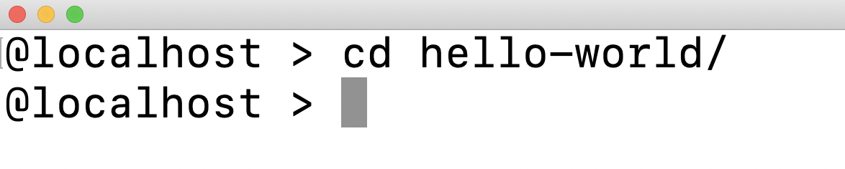
Let's make a change!
Change directory into the repo you cloned by typing the command below.
Note: If you did not name your repo hello-world, you should substitute hello-world with the name of your repo.

Slide 65
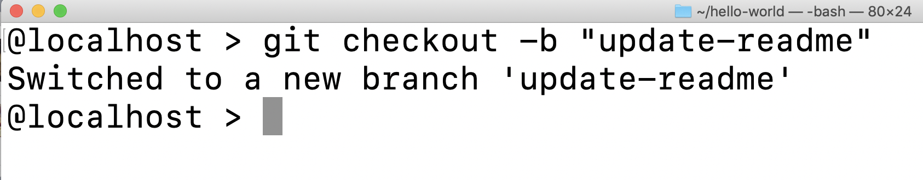
Let's make a change!
We're going to make some changes. You never want to commit directly to master, so let's checkout a new branch. You did this in the browser before. Use the command below to create a new branch.
Notes:
The -b flag lets git know that if the branch does not exist within the repository, it will go ahead and create it.

Slide 66
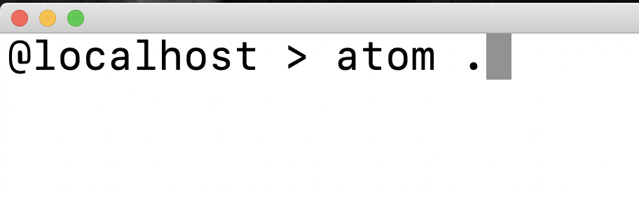
Let's make a change!
Open your project folder in the code editor of your choice. For example, if you have Atom installed, you can use the command below to open the project in Atom.

Slide 67
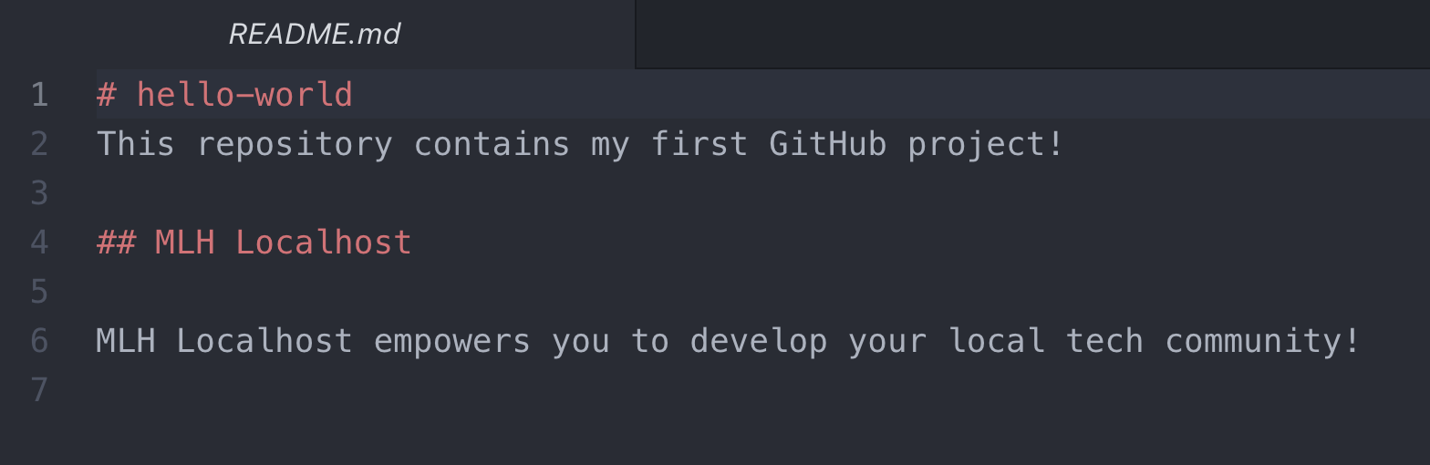
Let's make a change!
Make any changes you want to your README and save them.

Slide 68
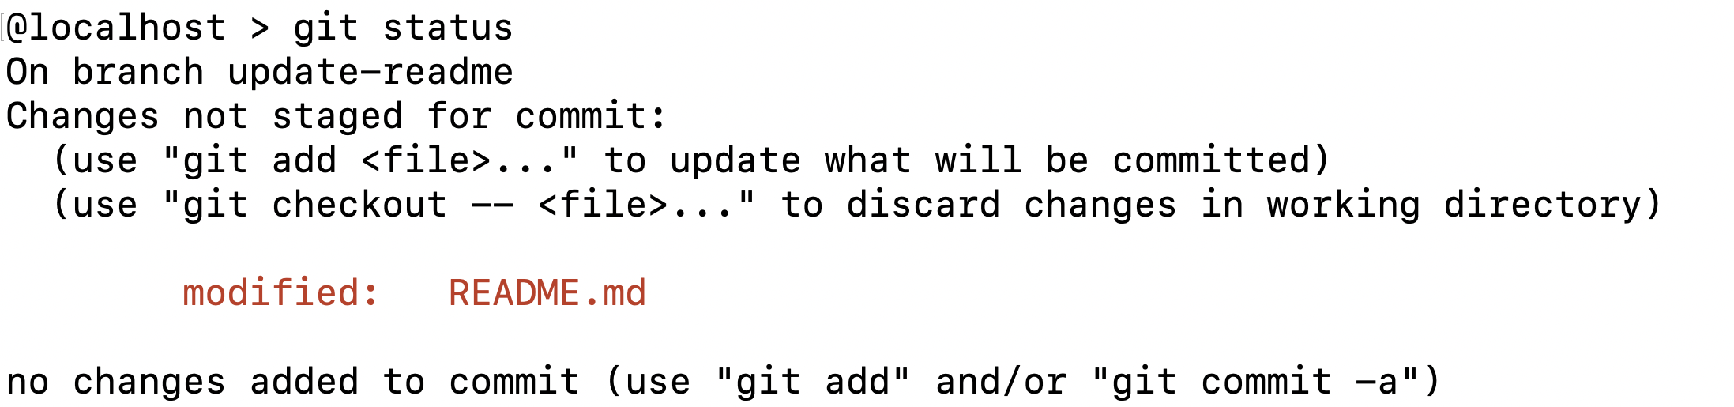
Let's make a change!
Return to your command line. Type the first command below. You should see output like this.
The output tells us that we have modified the README.md file. At the bottom, it tells us that we have not added any changes to commit. Let's do that now!

Slide 69
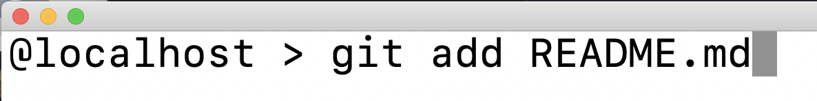
Let's make a change!
Type the command below. This command gets your changes ready to be committed.

Slide 70
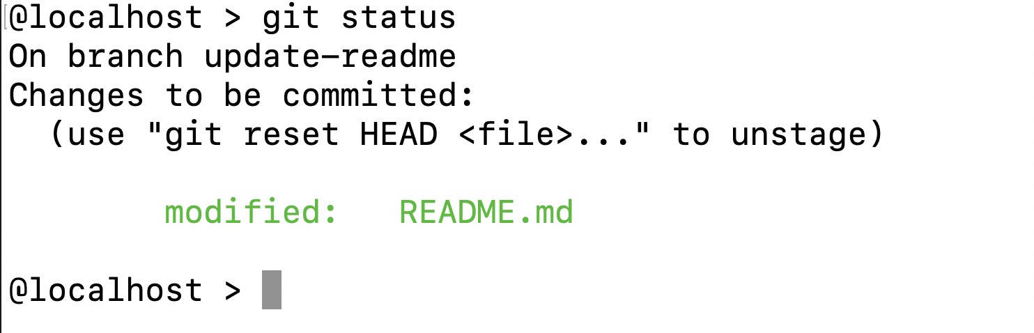
Let's make a change!
If you enter git status again, you will see that now the changes you made to README.md are ready to be committed!

Slide 71
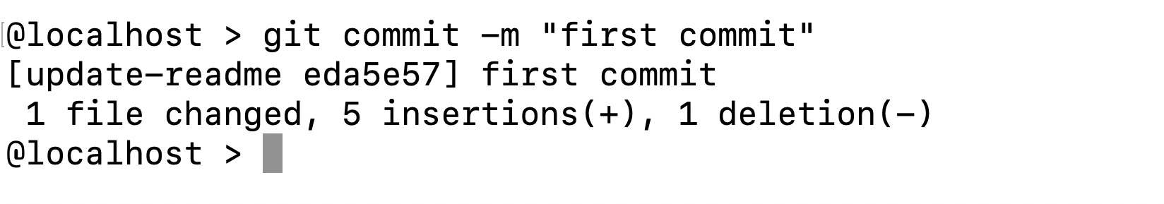
Let's make a change!
When you commit changes, you will include a commit message. This message should be descriptive of your changes. It's also a standard practice for your first commit to be "first commit."

Slide 72
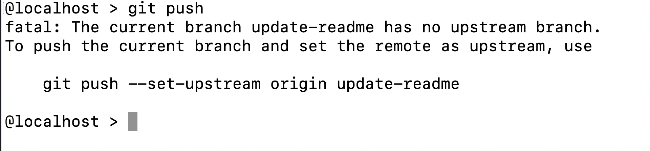
Let's make a change!
Now for a cool GitHub trick. We want to push the changes that we have committed up to GitHub. Type git push. Git will tell you the correct command! Copy and paste the command to add your local branch to GitHub and commit your changes.

Slide 73

Let's make a change!
You'll need to enter your GitHub username and password. Note: When typing your password, you won't see anything.

Slide 74

Let's make a change!
You will see this output. Now you can create a pull request in the browser like you did before by going to the URL provided.
Notes:
If you use the suggested URL, you can skip the next slide.
You can go back to the browser and make a pull request

Slide 75

Let's make a change!
Select Compare & pull request.

Slide 76

Let's make a change!
Name your pull request appropriately, then select Create Pull Request.

Slide 77

Let's make a change!
Finally, because you own the repo, you'll be able to merge your own pull request.

Slide 78

Let's make a change!
Now you want to make sure that your local master branch matches the master branch on GitHub. Return to your terminal and type the command below.

Slide 79
Let's make a change!
Finally, pull the changes on master down to your local repo with the command below.

Slide 80

Let's make a change!
Now you should be able to see your changes in the browser!

Slide 81
Let's recap quickly...
Git is a version control system allowing multiple people to collaborate
1
GitHub adds features to Git and provides a web interface
2
3
Command-line Git lets you propose changes without the web interface

Slide 82
4.

Slide 83
Keep Learning: Practice Problems for Later
Extra Practice Problem 1:
Configure Git with credentials so you don’t have to enter your password when pushing code.
Extra Practice Problem 2:
Use git stash to move changes between branches.
Notes:
What to Say:
Read the slide.
What to Do:
Encourage participants to try these problems on their own.

Slide 84
v.0.0.1

